Slide 1


SIMATS SCHOOL OF ENGINEERING SAVEETHA INSTITUTE OF MEDICAL AND TECHNICAL SCIENCES Regular Expressions for Real-World Text Processing DSA0302-Natural Language Processing
Presented by:
J.Raju (192325117)
Faculty:
Dr.T.Devi

Slide 2
INTRODUCTION
Regular Expressions (Regex) are patterns used to search and process text.
They help computers identify specific text formats quickly.
Regex is widely used in NLP, web development, cybersecurity, and data analysis.
It simplifies complex text-processing tasks and improves efficiency.
Regex helps automate repetitive tasks such as searching, validating, and extracting information from text.

Slide 3
Regular Expressions
A Regular Expression is a sequence of characters used to define a search pattern.
It helps in matching, finding, replacing, and extracting text.
A Regular Expression is a sequence of characters used to define a search pattern.
Symbol | Meaning
. | Matches any character
* | Zero or more occurrences
+ | One or more occurrences
? | Optional character
\d | Any digit (0-9)

Slide 4

Data Validation Using Regex
Ensures users enter information in the correct format.
Prevents invalid data from being stored in databases.
Validates emails, phone numbers, passwords, and IDs.
Example:^[A-Za-z0-9._%+-]+@[A-Za-z0-9.-]+\.[A-Za-z]{2,}$
Commonly used in registration forms and online applications.
EX:Banking Systems
University Admission Portals
Examples:
Phone Number Validation---^\d{10}$
Password Validation--^(?=.*[A-Z])(?=.*\d).{8,}$

Slide 5
Text Extraction and Information Retrieval
Regex helps extract useful information from unstructured text.
Extracts useful information from large text documents.
Identifies emails, dates, URLs, and phone numbers.
Reduces manual effort in data collection.
Examples:
Extract Email Addresses:
[A-Za-z0-9._%+-]+@[A-Za-z0-9.-]+\.[A-Za-z]{2,}
Extract URLs:
https?://\S+

Slide 6
Log Analysis and NLP Applications
Organizations generate thousands of log records daily.
Example Log
INFO: User Login Successful
ERROR: Database Connection Failed
WARNING: Low Disk Space
Regex Pattern
ERROR:.*
Uses in Log Analysis:
Detect System Errors
Monitor Security Threats
Identify Performance Issues
NLP Applications of Regex:
Tokenization (splitting text into words)
Chatbots and Virtual Assistants
Named Entity Recognition

Slide 7
IMPLEMENTATION
import re
text = """
Contact: student@gmail.com
Phone: 9876543210
Date: 15-07-2026
"""
email = re.findall(r'[A-Za-z0-9._%+-]+@[A-Za-z0-9.-]+\.[A-Za-z]{2,}', text)
phone = re.findall(r'\d{10}', text)
date = re.findall(r'\d{2}-\d{2}-\d{4}', text)
print("Email:", email)
print("Phone:", phone)
print("Date:", date)

Slide 8
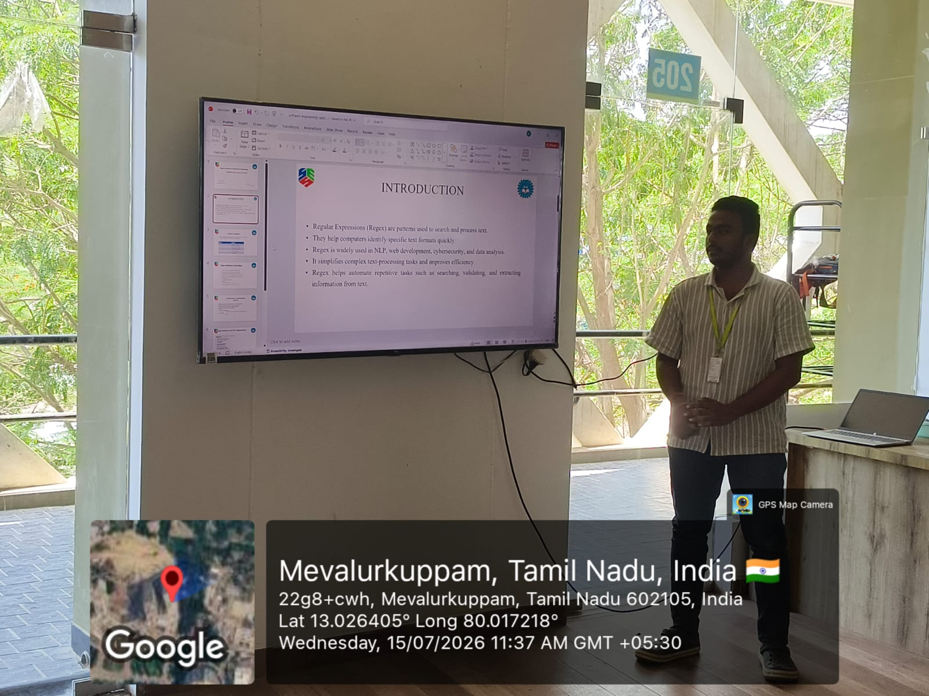

Slide 9
THANK YOU

